Slide 1
INTRODUCTION TO
SOFTWARE ENGINEERING
Project Management

Slide 2
Objectives
To know the principal tasks of software project managers
To understand the need for project planning in all software projects
Know how graphical representations (bar charts and activity charts) can be used by project managers to represent project schedules
To introduced to the notion of risk management and some of the risks that can arise in software projects.

Slide 3
The Management Spectrum
Effective software project management focuses on these items
4 P’s
The People
The Product
The Process
The Project

Slide 4
The Management Spectrum
The people
Deals with the cultivation of motivated, highly skilled people
Consists of the stakeholders, the team leaders, and the software team
The product
Product objectives and scope should be established before a project can be planned

Slide 5
The Management Spectrum
The process
The software process provides the framework from which a comprehensive plan for software development can be established
The project
Project can be defined as a set of interrelated tasks to be executed over a fixed period and within certain cost and other limitations(scope).
Planning and controlling a software project is done for one primary reason…it is the only known way to manage complexity
In a 1998 survey, 26% of software projects failed outright, 46% experienced cost and schedule overruns

Slide 6
Project Scope
To define a project scope, you must first identify the following things:
Project objectives/Goals
Sub-phases
Tasks
Resources
Budget
Schedule

Slide 7
Project Management Concepts
Software project management Activities:
Project planning
Project scheduling
Risk management
Managing people
Software cost estimation
Quality management

Slide 8
Project Plan
The biggest single problem that afflicts software developing is that of under estimating resources required for a project.
Developing a realistic project plan is essential to gain an understanding of the resources required, and how these should be applied.

Slide 9
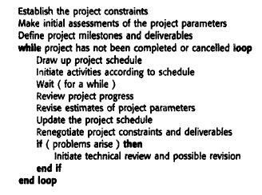
Project Planning
Notes:
Constraints (required delivery date, staff available, overall budget, etc.)
parameters such as its structure, size, and distribution of functions.

Slide 10
Types of Plan
Plan | Description
Software development plan | The central plan, which describes how the system will be developed.
Quality assurance plan | Specifies the quality procedures & standards to be used.
Validation plan | Describes the approach, resources and schedule used for system validation. Defines how a client will validate the system that has been developed.
Configuration management plan | Defines how the system will be configured and installed.
Maintenance plan | Predicts the maintenance requirements of the system, maintenance costs and effort required.
Staff development plan | Describes how the skills and experience of the project team members will be developed.

Slide 11
The Software Development Plan
This is usually what is meant by a project plan.
Specifies the order of work to be carried out, resources, responsibilities, and so on.
Varies from small and relatively informal to large and very formal.
Developing a project plan is as important as properly designing code.
On the basis of a project plan, contracts will be signed

Slide 12
Structure of Development Plan
Introduction
brief introduction to project —references to requirements specification
Project organization
Describe the way development team organized, people involved, and their roles in team
Risk Analysis
what are the key risks to the project, likelihood of risk arising, risk reduction procedures.
Hardware and software resources
what h/ware and s/ware resources will be required for the project and when?

Slide 13
Structure of Development Plan
Work breakdown
The project divided into activities, milestones, deliverables etc
Project schedule
estimated time required to reach each milestone ,dependencies between activities & allocation of people
Reporting and progress measurement
mechanisms to monitor progress

Slide 14
Work break down Structure
There are many ways of breaking down the activities in a project, but the most usual is into:
work packages;
tasks;
deliverables;
milestones.

Slide 15
WBS Example
Level 1
ABC Project
Level 2
Definition
Analysis
Design
Programming
...
Level 3
Requirements
Documentation
Feasibility
Study
Risk Analysis
...

Slide 16
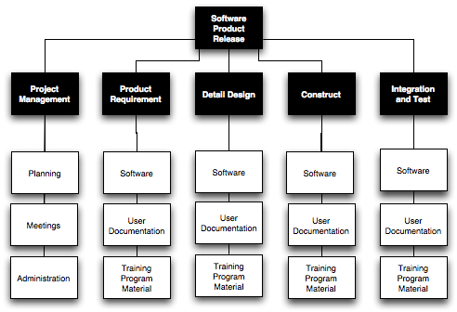

Slide 17
Work Package and Tasks
A work package is a large, logically distinct section of work:
typically at least 12 months duration;
may include multiple concurrent activities;
independent of other activities;
but may depend on, or feed into other activities;
typically allocated to a single team.
A task is typically a much smaller piece of work:
A part of a work package.
typically 3–6 person months effort;
may be dependent on other concurrent activities;
typically allocated to a single person.

Slide 18
Deliverable and Milestone
A deliverable is an output of the project that is delivered to customer usually at the end of some major phase.
Example
a report (e.g., requirements spec);
code (e.g., alpha tested product).
Deliverables are indicators (but only indicators) of progress.
Deliverables are usually milestones, but milestones need not be deliverables.

Slide 19
Milestone
A milestone is a point at which progress on the project may be assessed.
may be internal project results that are used by the project manager to check project progress
Completion of an activity or deliverable (must be measurable).
Activities must have definite start and stop.
A milestone is point in time not a time period like an activity.
EXAMPLES:
delivery of requirements spec
delivery of alpha tested code

Slide 20
Documentation
For each work package & task, it is usual to document:
brief description;
earliest start date;
earliest end date;
total person months effort;
pre-requisite WPs or tasks;
dependent WPs or tasks;
who is responsible.

Slide 21
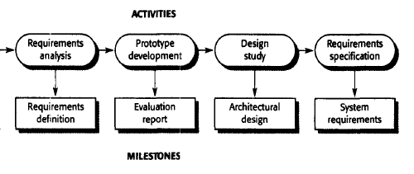
Milestones and Deliverables

Slide 22
Project Scheduling
“Its All About Time”
Scheduling:
“estimate the time and resources required to complete activities and organise them into a coherent sequence”
relative timing of tasks & time frames
a concise description of the plan

Slide 23
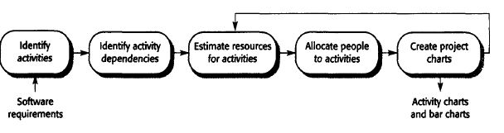
Project Scheduling

Slide 24
Identifying the Activities of a Project
To determine optimal schedules we need to
Identify all the project’s activities.
Determine the precedence relations among activities.
Based on this information we can develop managerial tools for project control.

Slide 25
Activity Network Diagrams
An activity network diagram graphical notations that are used to illustrate the project schedule.
a network of tasks needed to complete a project,
their interdependencies
the times required for each task.
There are a number of activity network techniques which are similar in nature. The most commonly used technique is CPM (Critical Path Method).

Slide 26
The CPM Approach for Project Scheduling
The critical path is the sequence of dependent
activities that defines the time required to complete the project.
The CPM approach to project scheduling uses network presentation of the project to
Reflect activity precedence relations
Activity completion time
CPM is used for scheduling activities such that the project’s completion time is minimized.
Notes:
The minimum time required to finish the project can be estimated by considering
the longest path in the activity graph (the critical path).

Slide 27
Example
Precedence/Dependences Relationships Chart
Activity | Predecessor | Duration
A | None | 90
B | A | 15
C | B | 5
D | G | 20
E | D | 21
F | A | 25
G | C,F | 14
H | D | 28
I | A | 30
J | D,I | 45

Slide 28
Immediate Predecessor
From the activity description chart, we can determine immediate predecessors for each activity.
Activity A is an immediate predecessor
of activity B, because it must be competed
just prior to the commencement of B.
Example: A may be the component design & B is its implementation
A
B

Slide 29
Basic Terms In CPM
ES stands for Early Start
the earliest an activity can begin.
AD stands for Activity Duration
the length of time needed to complete an activity.
EF stands for Early Finish
the earliest an activity can finish. EF + AD
LF stands for Late Finish
the latest an activity can finish.
LS stands for Late Start
the latest an activity can begin. LF – AD

Slide 30
The Forward Pass
Earliest Start Time / Earliest Finish Time
Make a forward pass through the network as follows:
Evaluate all the activities which have no immediate predecessors.
The earliest start for such an activity is zero ES = 0.
The earliest finish is the activity duration EF = Activity duration.
Evaluate the ES of all the nodes for which EF of all the immediate predecessor has been determined.
ES = Max EF of all its immediate predecessors.
EF = ES + Activity duration.
Repeat this process until all nodes have been evaluated
EF of the finish node is the earliest finish time of the project.

Slide 31
Earliest Start / Earliest Finish – Forward Pass
90,105
105,110
170
149,170
B
C
E
B
15
C
5
E
21
110,124
0,90
90,115
177
115,129
129,149
149,177
F
G
H
F
25
G
14
D
20
H
28
A
D
194
A
90
EARLIEST FINISH
120,165
194
90,120
149,194
J
I
J
45
I
30

Slide 32
The Backward Pass
Latest start time / Latest finish time
Make a backward pass through the network as follows:
Evaluate all the activities that immediately precede the finish node.
The latest finish for such an activity is LF = minimal project completion time.
The latest start for such an activity is LS = LF - activity duration.
Evaluate the LF of all the nodes for which LS of all the immediate successors has been determined.
LF = Min LS of all its immediate successors.
LS = LF - Activity duration.
Repeat this process backward until all nodes have been evaluated.

Slide 33
Latest Start / Latest Finish – Backward Pass
149,170
90,105
105,110
173,194
E
21
B
E
B
15
C
C
5
110,115
95,110
90,115
115,129
129,149
149,177
90, 115
115,129
129,149
5,95
153,173
166,194
0,90
129,149
F
129,149
146,166
F
25
D
D
20
H
G
H
28
A
0,90
G
14
129,149
A
90
129,149
194
129,149
129,149
129,149
129,149
29,119
149,194
90,120
149,194
119,149
J
I
J
45
I
30

Slide 34
Slack Times
Activity start time and completion time may be delayed by planned reasons as well as by unforeseen reasons.
Some of these delays may affect the overall completion date.
To learn about the effects of these delays, we calculate the slack time, and form the critical path.

Slide 35
Slack Times
Slack time is the amount of time an activity can be delayed without delaying the project completion date, assuming no other delays are taking place in the project.
Slack Time = LS - ES = LF - EF

Slide 36
Slack time in the Example
Critical activities
must be rigidly
scheduled

Slide 37
The Critical Path
The critical path is a set of activities that have no slack, connecting the START node with the FINISH node.
The critical activities (activities with 0 slack) form at least one critical path in the network.
A critical path is the longest path in the network.
The sum of the completion times for the activities on the critical path is the minimal completion time of the project.

Slide 38
Critical Path
“The specific set of sequential tasks upon which the project completion date depends”
or “the longest full path”
All projects have a Critical Path
Accelerating non-critical tasks do not directly shorten the schedule

Slide 39
The Critical Path
90,105
105,110
149,170
E
21
B
E
B
15
C
95,110
C
5
110,115
173,194
0,90
90,115
115,129
129,149
149,177
0,90
90, 115
115,129
129,149
166,194
F
F
25
D
D
20
H
G
H
28
A
G
14
A
90
149,194
90,120
149,194
119,149
J
I
J
45
I
30

Slide 40
Example
Activity | Description | Duration | Predecessor
START | Kick-off meeting
A | Planning | 24 | START
B | Wireframes | 16 | A
C | Wireframe Approval | 24 | B
D | Design | 20 | C
E | Design Approval | 24 | D
F | Content Development | 48 | E
G | Back-End Development | 60 | E
H | Front-End Development | 40 | E
I | Content Import | 8 | F, G, H
J | Testing | 32 | G, H
K | Review | 40 | I, J
L | Launch | 4 | K
END |  |  | L

Slide 41
GANTT charts
GANTT charts are a project planning tool that can be used to represent the timing of tasks required to complete a project.
Gantt charts are a kind of bar chart:
time plotted on x axis
bars on y axis for each activity.

Slide 42
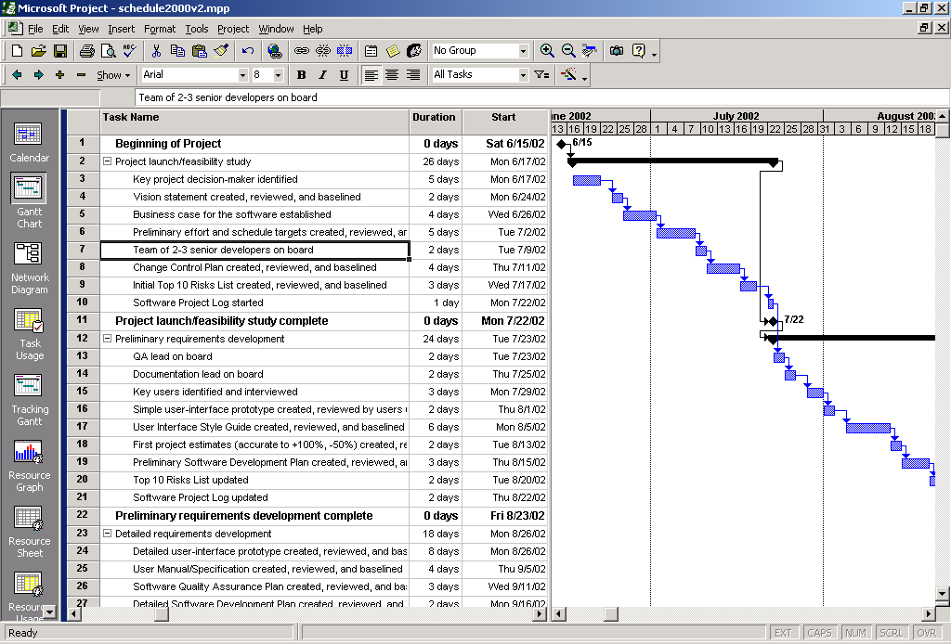
Example

Slide 43
Risk Management
It involves anticipating risks that might affect the project schedule or the quality of
the software being developed and taking action to avoid these risks

Slide 44
Three categories of Risk
Project risks: are risks that affect the project schedule or resources. An example might be the loss of an experienced designer.
Product risks: are risks that affect the quality or performance of the software being developed. An example might be the failure of a purchased component to perform as expected.
Business risks: are risks that affect the organization developing or procuring the software. For example, a competitor introducing a new product is a business risk.

Slide 45
Possible Software Risks
Risk | Risk Type | Description
Staff turnover | Project | Experienced staff will leave the project before it is finished.
Management change | Project | There will be a change of organizational management with different priorities.
Hardware unavailability | Project | Hardware which is essential for the project will not be delivered on schedule.
Requirements change | Project and Product | There will be a larger number of changes to the requirements than anticipated.
Specification delays | Project and Product | Specifications of essential interfaces are not available, on schedule.
Size underestimate | Project and Product | The size of the system has been product underestimated.
Case tool under performance | Product | CASE tools which support the project do performance not perform as anticipated.
Technology change | Business | The underlying technology on which the system is built is superseded by new technology.
Product competition. | Business | A competitive product is marketed before the system will completed.

Slide 46
The Risk Management Process
Risk identification: Possible project, product and business risks are identified.
Risk analysis: The likelihood and consequences of these risks are assessed.
Risk planning: Plans to address the risk either by avoiding it or minimizing its effects on the project are drawn up.
Risk monitoring: The risk is constantly assessed and plans for risk mitigation are revised as more information about the risk becomes available.

Slide 47
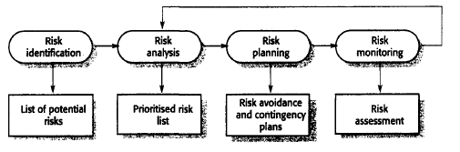
The Risk Management Process

